Slide 1
Final Project Migrating MongoDB databases to CosmosDB
Hu, Zhenglin
Deep Azure@McKesson
Dr. Zoran B. Djordjević

Slide 2

Problem Statement
Azure CosmosDB (released May 2017) database service is a new product built on top of Microsoft successful product: DocumentDB (released 2014).
CosmosDB supports key-value, column-oriented, document and Graph models with popular NoSQL API support: SQL, MongoDB, Table, Graph and Cassandra.
The database service offers auto-scaling, HA, DR, globally distributed, and replication.
We are in the process of moving some MongoDB instances on-premise or in cloud VMs to CosmosDB

Slide 3
Datasets Used in this Project
Northwind csv files from https://github.com/tmcnab/northwind-mongo/archive/master.zip. Northwind sample database is from Microsoft Access product. There are 11 tables with 3308 rows.
mongodb_cases.json from https://community.jaspersoft.com/wiki/mongodb-city-cases-example. There are 10,000 json documents in this dataset. It is about service cases in a city.

Slide 4
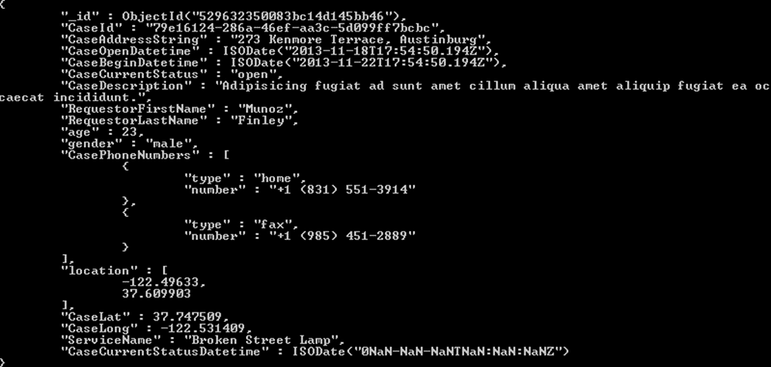
Sample Data

Slide 5
Hardware and Software
Windows 7
MongoDB Enterprise Server 3.6.1.

Slide 6
High-Level Steps
Install MongoDB, clean the data and load sample data into databases
Backup the databases in MongoDB which are ready for loading to CosmosDB
Create a CosmosDB account on portal.azure.com
Determine restore parameters for batch size and number of workers.
Restore the backups to CosmosDB using MongoDB API. Pre-create CosmosDB databases and collections if the default throughput 1000 RU/s is too slow.

Slide 7
Install MongoDB
MongoDB Enterprise Server download: https://www.mongodb.com/lp/download/mongodb-enterprise?jmp=nav
Save mongodb-win32-x86_64-enterprise-windows-64-3.6.1-signed.msi
Run this msi file and use all defaults
Add C:\Program Files\MongoDB\Server\3.6\bin to the PATH env variable
Create a database folder: mkdir C:\data\db

Slide 8
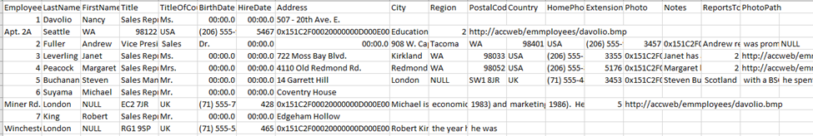
Data Cleansing
Address and Note fields contain coma in the employees CSV file. Create problems for loading into MongoDB. Added double quote for the field to resolve the loading issue.

Slide 9
Load Sample Data into MongoDB
C:\Users\elqtrlx\Documents\Azure-Deep-Dive\Lesson 17\northwind-mongo-master\northwind-mongo-master>run_import.bat
C:\Users\elqtrlx\Documents\Azure-Deep-Dive\Lesson 17\northwind-mongo-master\northwind-mongo-master>mongoimport -d northwind -c categories --type csv --file categories.csv --headerline
2018-01-29T16:55:38.614-0600 connected to: localhost
2018-01-29T16:55:38.643-0600 imported 8 documents
C:\Users\elqtrlx\Documents\Azure-Deep-Dive\Lesson 17\northwind-mongo-master\northwind-mongo-master>mongoimport -d northwind -c customers --type csv --file customers.csv --headerline
2018-01-29T16:55:38.872-0600 connected to: localhost
2018-01-29T16:55:38.910-0600 imported 91 documents
.
.
.

Slide 10
Load Sample Data into MongoDB
C:\Users\elqtrlx\Documents\Azure-Deep-Dive\Lesson 17>mongoimport --host localhost --db test --collection cases < mongodb_cases.json
2018-01-29T17:52:38.994-0600 connected to: localhost
2018-01-29T17:52:39.566-0600 imported 10000 documents
MongoDB Enterprise > use test
switched to db test
MongoDB Enterprise > show collections
cases
MongoDB Enterprise > db.cases.find().count()
10000
MongoDB Enterprise >

Slide 11
Backup Two Databases (northwind and test)
C:\Users\elqtrlx\Documents\Azure-Deep-Dive\Lesson 17>mongodump --db northwind --out northwind_dump
2018-01-31T12:52:17.829-0600 writing northwind.orderdetails to
2018-01-31T12:52:17.830-0600 writing northwind.orders to
2018-01-31T12:52:17.830-0600 writing northwind.customers to
.
.
.
.
2018-01-31T12:52:17.849-0600 done dumping northwind.regions (4 documents)
2018-01-31T12:52:17.850-0600 done dumping northwind.shippers (3 documents)
C:\Users\elqtrlx\Documents\Azure-Deep-Dive\Lesson 17>mongodump --db test --out test_dump
2018-01-31T12:51:51.244-0600 writing test.cases to
2018-01-31T12:51:51.340-0600 done dumping test.cases (10000 documents)

Slide 12
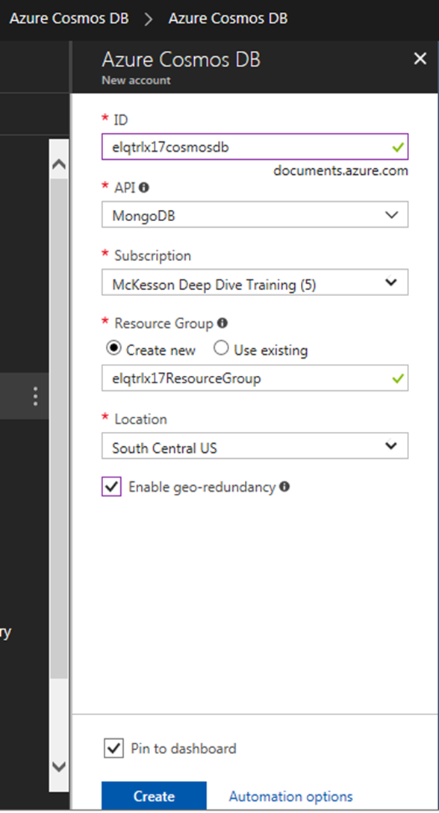
Create cosmosDB account on Azure

Slide 13
Determine Request Charge
globaldb:PRIMARY> use scratch
switched to db scratch
globaldb:PRIMARY> show collections
scratch1
globaldb:PRIMARY> db.scratch1.insert({ "playerId": "a067ff", "hashedid": "bb0091", "countryCode": "h
k" })
WriteResult({ "nInserted" : 1 })
globaldb:PRIMARY> db.runCommand({getLastRequestStatistics: 1})
{
"_t" : "GetRequestStatisticsResponse",
"ok" : 1,
"CommandName" : "insert",
"RequestCharge" : 8.76,
"RequestDurationInMilliSeconds" : NumberLong(17)
}

Slide 14
Determine the Latency
globaldb:PRIMARY> setVerboseShell(true)
globaldb:PRIMARY> db.scratch1.find().limit(1)
{ "_id" : ObjectId("5a721f72dab943d858c1a5cd"), "playerId" : "a067ff", "hashedid" : "bb0091", "count
ryCode" : "hk" }
Fetched 1 record(s) in 72ms
This is equivalent to 1/(0.001*72)=1000/72=13.89 RU/s

Slide 15
Determine batch size and workers
Provisioned Throughput: 10000 RU/s.
BatchSize: 10000/13.89 = 720. Use 24 as batchsize per https://docs.microsoft.com/en-us/azure/cosmos-db/mongodb-migrate
Property Value
batchSize 24
RUs provisioned 10000
Latency 0.072 s
RU charged for 1 doc write 8.76 RUs
numInsertionWorkers (10000 RUs x 0.072 s) / (24 x 8.76 RUs) = 3.425 (use 4)

Slide 16
Restore database to CosmosDB
C:\Users\elqtrlx\Documents\Azure-Deep-Dive\Lesson 17>run_restore.northwind.bat
2018-01-31T15:28:33.342-0600 preparing collections to restore from
2018-01-31T15:28:33.415-0600 reading metadata for northwind.orders from northwind_dump\northwind\orders.metadata.json
2018-01-31T15:28:33.482-0600 reading metadata for northwind.orderdetails from northwind_dump\northwind\orderdetails.metadata.json
.
.
.
2018-01-31T15:28:44.180-0600 [########################] northwind.orderdetails 207KB/207KB (100.0%)
2018-01-31T15:28:46.744-0600 [########################] northwind.orderdetails 207KB/207KB (100.0%)
2018-01-31T15:28:46.745-0600 no indexes to restore
2018-01-31T15:28:46.745-0600 finished restoring northwind.orderdetails (2155 documents)
2018-01-31T15:28:46.745-0600 done

Slide 17
Restore Database to CosmosDB
Pre-create db test and collection cases on portal with throughput 10,000 RU/s
C:\Users\elqtrlx\Documents\Azure-Deep-Dive\Lesson 17>run_restore.test.bat
Using --numInsertionWorkersPerCollection 4 --numParallelCollections 24
2018-01-31T14:26:04.524-0600 error: Message: The request rate is too large. Please retry after sometime. ActivityId: f174511b-0000-0000-0000-000000000000, Request URI: /apps/97eda9fb-4d31-43ec-816e-e341bfd2b031/services/c31c35b8-bd10-40c7-a371-0a2ce3bf2c61/partitions/cb85e3cb-9d40-4c43-a842-293eb1fb8c32/replicas/131619034262500996p, RequestStats: , SDK: Microsoft.Azure.Documents.Common/1.19.162.2
2018-01-31T14:26:06.462-0600 [########################] test.cases 6.07MB/6.07MB (100.0%)
2018-01-31T14:26:06.462-0600 restoring indexes for collection test.cases from metadata
2018-01-31T14:26:06.716-0600 finished restoring test.cases (10000 documents)
2018-01-31T14:26:06.716-0600 done

Slide 18
Restore Database to CosmosDB
C:\Users\elqtrlx\Documents\Azure-Deep-Dive\Lesson 17>run_restore.test.bat
Using --numInsertionWorkersPerCollection 1 --numParallelCollections 6
2018-01-31T16:11:39.125-0600 preparing collections to restore from
2018-01-31T16:11:39.195-0600 reading metadata for test.cases from test_dump\test\cases.metadata.json
2018-01-31T16:11:39.196-0600 restoring test.cases from test_dump\test\cases.bson
2018-01-31T16:11:41.359-0600 [##......................] test.cases 624KB/6.07MB (10.0%)
2018-01-31T16:12:02.359-0600 [########################] test.cases 6.07MB/6.07MB (100.0%)
2018-01-31T16:12:04.712-0600 [########################] test.cases 6.07MB/6.07MB (100.0%)
2018-01-31T16:12:04.712-0600 restoring indexes for collection test.cases from metadata
2018-01-31T16:12:04.964-0600 finished restoring test.cases (10000 documents)
2018-01-31T16:12:04.965-0600 done
(need significantly lower the parallel workers and batchsize)

Slide 19
Issues and Lessons Learned
Uploading JSON documents to CosmosDB is slow. For a simple document, need about 0.072s which is equivalent of 14 documents/s. For a million documents, the rough estimate is that we need about one day.
We could increase the throughput above 10,000 RU/s to spead up the upload, but we need to implement sharding. When the collection size is larger than 10GB, sharding is also required. As JSON documents are schema free and no required constraint for a partition key as required by sharding. Thus, the application needs to ensure that there are candidate partition keys in the document.

Slide 20
YouTube URLs, GitHub URL
Two minute (short): https://youtu.be/9vDRBgPeT50
15 minutes (long): https://youtu.be/KHFuEFOMIH4
GitHub Repository with all artifacts: https://github.com/linnhu3210/week17

